Slide 1
Spatial Profile of the Squeezed Quantum Noise Generated and Modified by Resonant Atomic Ensembles
Mi Zhang, Irina Novikova, Eugeniy E. Mikhailov
College of William & Mary
R. Nicholas Lanning, Jonathan P. Dowling
Louisiana State Univ.

Slide 2
Squeezed State
Quantum Fluctuations in Light field:
$$E\left(φ\right)=\left|a\right|e^{−iφ}=\left|a\right|sin\left(φ\right)+i\left|a\right|cos\left(φ\right)=X_{1}+iX_{2}$$
Coherent State
Standard Quantum Limit
$$δX_{1}=δX_{2}$$
$$δX_{1}δX_{2}=\frac{1}{4}$$
Squeezed State
Squeezed Quantum Noise
$$δX_{1}≠δX_{2}$$
$$δX_{1}δX_{2}≥\frac{1}{4}$$

Slide 3
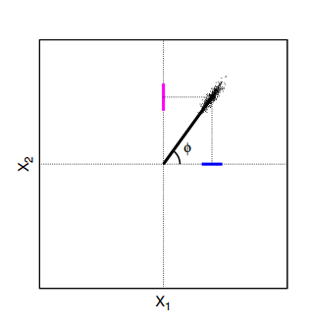
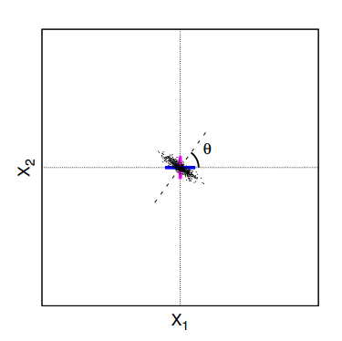
Squeezed Vacuum State
Squeezed State
Squeezed Vacuum State

Slide 4
Polarization Self-Rotation
A.B. Matsko et al., PRA 66, 043815 (2002): theoretically prediction of 4-6 dB noise suppression
$$a_{out}=a_{in}+\frac{igL}{2}\left(a_{in}^{†}−a_{in}\right)$$

Slide 5
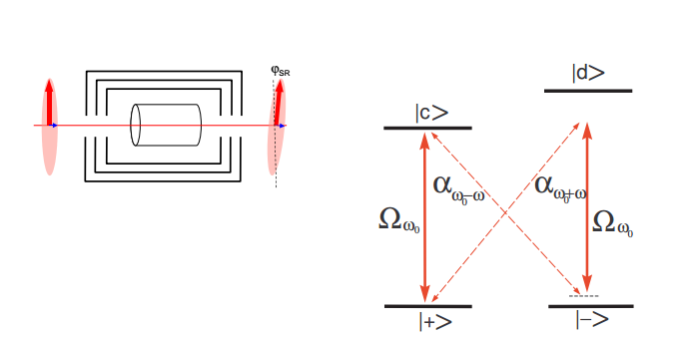
Polarization Self-Rotation
A.B. Matsko et al., PRA 66, 043815 (2002): theoretically prediction of 4-6 dB noise suppression
$$a_{out}=a_{in}+\frac{igL}{2}\left(a_{in}^{†}−a_{in}\right)$$

Slide 6
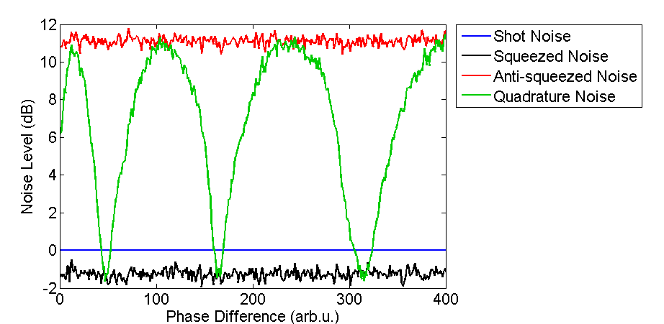
Setup
SMPM fiber - single-mode polarization-maintaining fiber
λ/2 - half-wave plate
GP - Glan-laser polarizer
PBS - polarizing beam splitter
PhR - phase-retarding wave plate
BPD - balanced photodetector

Slide 7
Development of Squeezing in atomic vapors

Slide 8
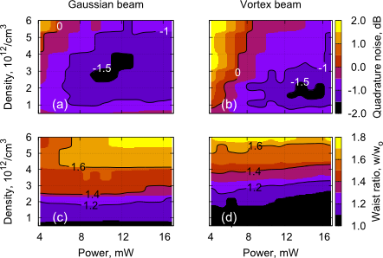
Self-(de)focusing
Expansion caused by Self-defocusing is irrelevant to squeezing amount.
Mi Zhang, Joseph Soultanis, Irina Novikova, and Eugeniy E. Mikhailov, Optics Letters, Vol. 38, Issue 22, pp. 4833-4836 (2013)

Slide 9
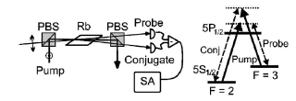
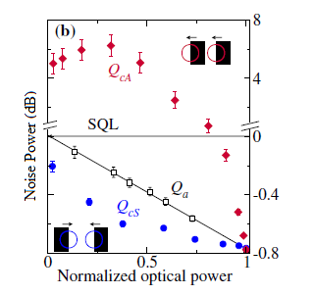
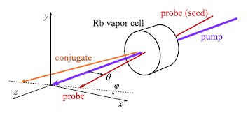
Spatial structure of beam after interaction
C. F. McCormick, V. Boyer, E. Arimondo, and P. D. Lett, Optics Letters, Vol. 32, Issue 2, pp. 178-180 (2007)
V. Boyer, A. M. Marino, and P. D. Lett, Phys. Rev. Lett. 100, 143601 (2008)

Slide 10
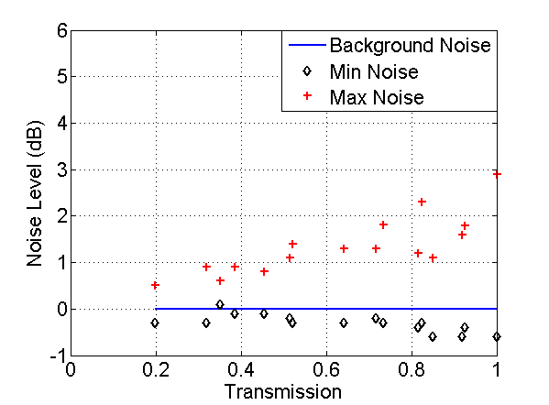
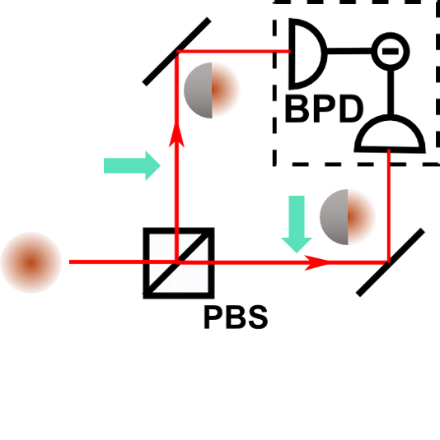
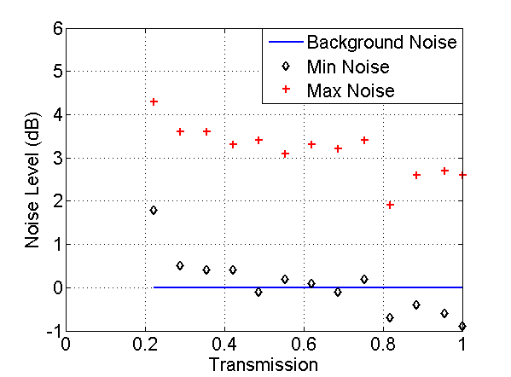
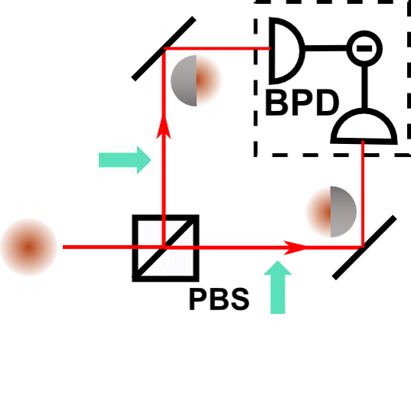
Spatial Mask – Sharp Edge
Blocking beams from the same sides is equivalent to modification before splitter.
Beams blocked from opposite sides.

Slide 11
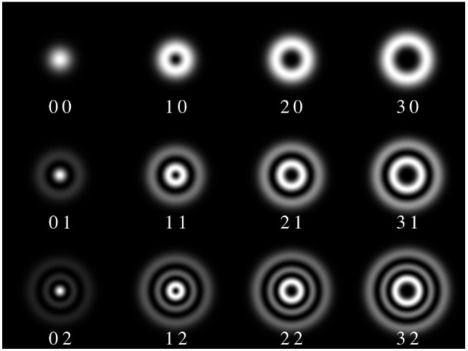
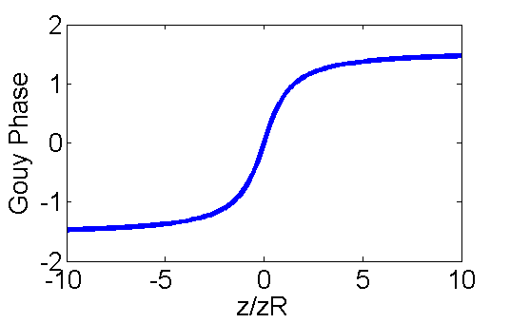
Laguerre Gaussian modes
Guoy Phase $ς\left(z\right)=arctan\left(\frac{z}{z_{R}}\right)$,
has a $π$ shift across the focus
$$u_{pl}^{LG}=\frac{C_{pl}^{LG}}{w\left(z\right)}{\left(\frac{r\sqrt{2}}{w\left(z\right)}\right)}^{\left|l\right|}exp\left[−\frac{r^{2}}{w^{2}\left(z\right)}\right]L_{p}^{\left|l\right|}exp\left[−\frac{ikr^{2}z}{2\left(z^{2}+z_{R}^{2}\right)}\right]\left(−ilφ\right)exp\left[i\left(2p+\left|l\right|+1\right)\tan^{−1}\frac{z}{z_{R}}\right]$$
l : azimuthal index
p : radial index
L Allen, M.J Padgett, Optics Communications, Volume 184, Issues 1–4, 1 October 2000

Slide 12
Spatial Mask – Ring Mask

Slide 13
Spatial Mask – Circular Mask

Slide 14
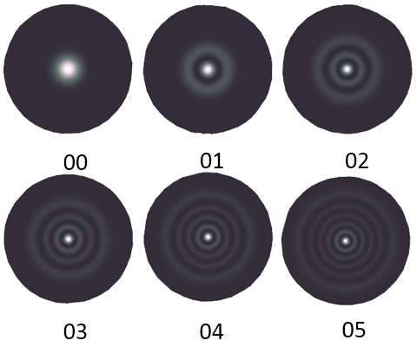
Possible composition of beam
Instead of sending in higher LG modes, we might be generating them.
Propagation function:
$$\hat{L}Ω_{x}=−i\left(\frac{κ}{Δ}\right){\left(u^{∗}u\right)}^{2}Ω_{x}$$
Solution:
$$Ω_{x}=Ω_{x0}+\sum_{p}{u_{0p}\int{{dz}^{′}c_{p}\left(z^{′}\right),}}$$
$$c_{p}\left(z^{′}\right)=\int{r^{′}{dr}^{′}u_{0p}^{∗}}\left(r^{′},z^{′}\right)ρ_{x}\left(r^{′},z^{′}\right)$$
Q : How Many Modes Should We Add?
A : 5.

Slide 15
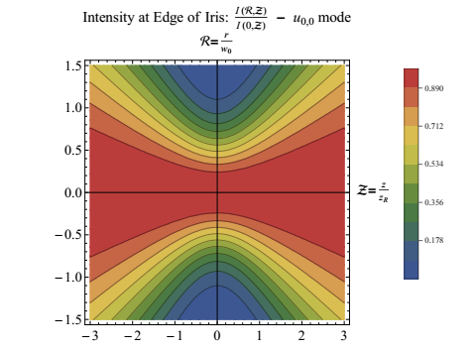
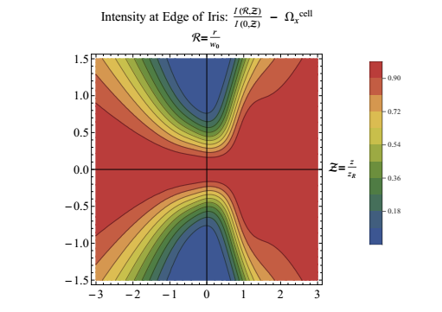
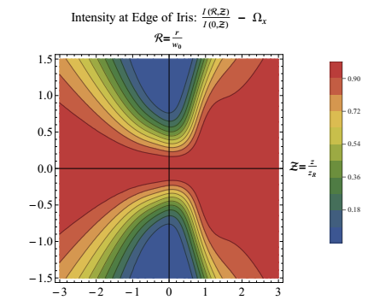
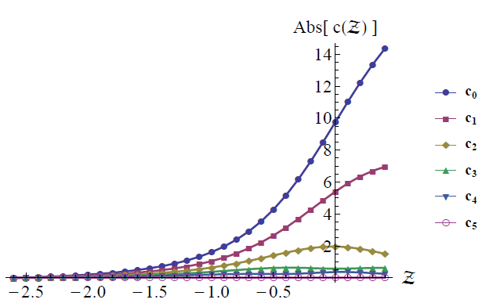
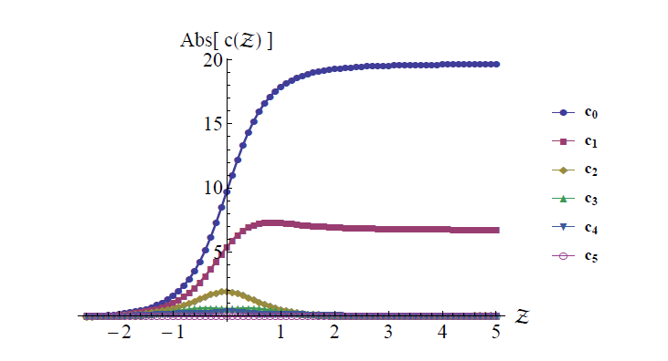
Evolution of multimode beam
Longer cell?

Slide 16
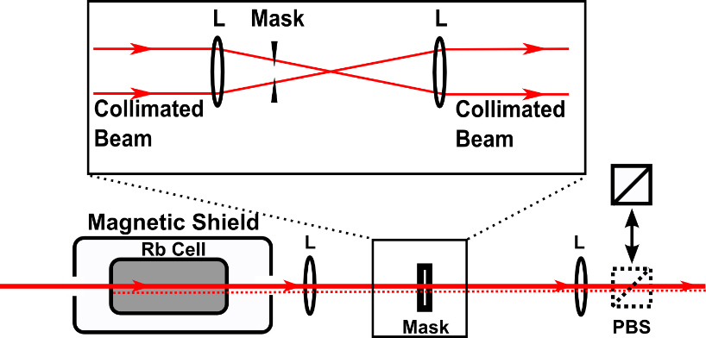
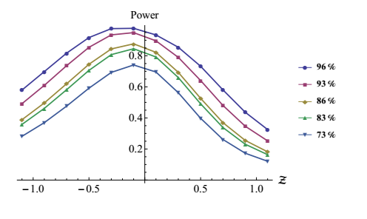
Fixed Iris Size

Slide 17
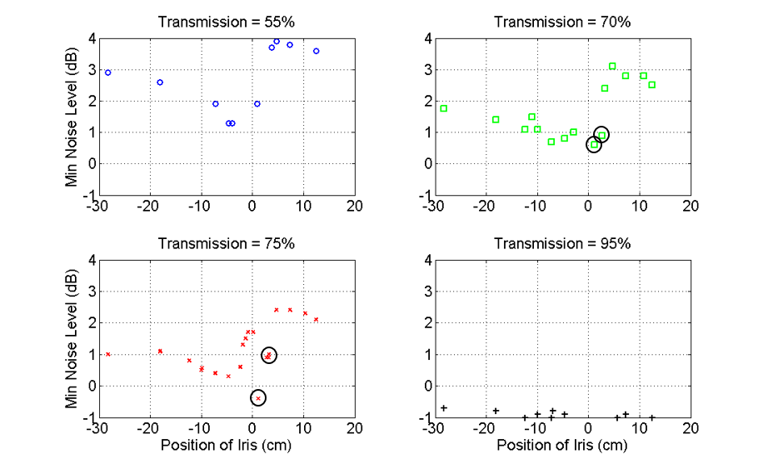
Fixed Transmission
Guoy Phase $ς\left(z\right)=arctan\left(\frac{z}{z_{R}}\right)$,
has a $π$ shift across the focus

Slide 18
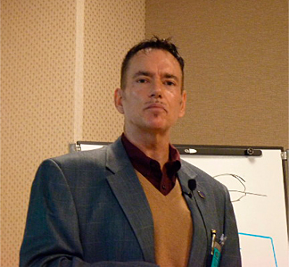
Acknowledgment
Quantum Optics at William&Mary (from left to right):
Irina Novikova, Eugeniy Mikhailov, Ashna Aggarwal, Kelly Roman, Owen Wolfe, Haley Bauser, Mi Zhang, Ellie Radue, Hunter Rew, Wenqing Zhao, Gleb Romanov, Matt Simons
Jonathan P. Dowling
R. Nicholas Lanning

Slide 19
Conclusion
We generated a squeezed vacuum state from polarization self-rotation.
The squeezed vacuum state consists of high order Laguerre Gaussian modes with different squeezing parameters.

